Slide 1
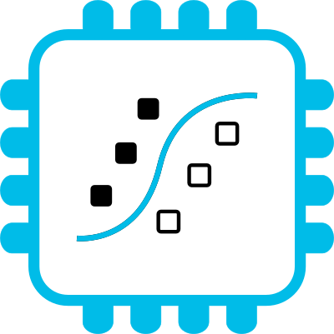



Sensor data processing on microcontrollers with MicroPython
https://github.com/emlearn/emlearn-micropython
Jon Nordby <jononor@gmail.com> EuroSciPy, Krakow, August 2025

Slide 2
Sprint MicroPython / emlearn
On Friday!

Slide 3
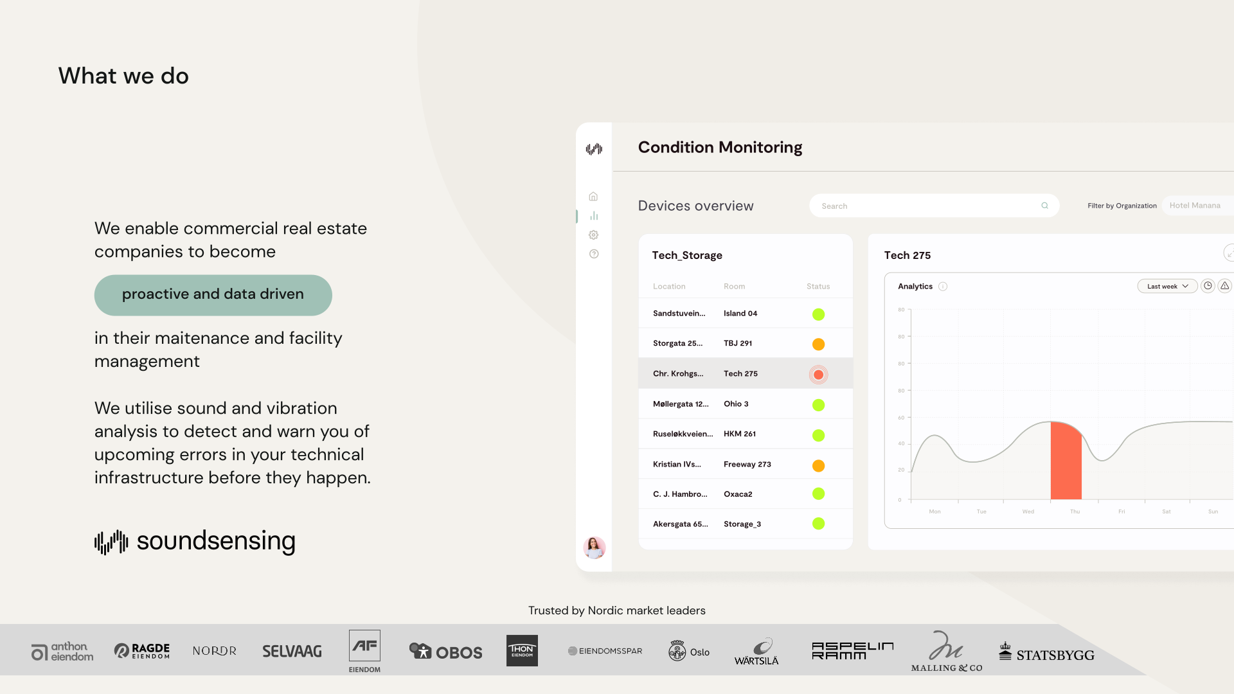
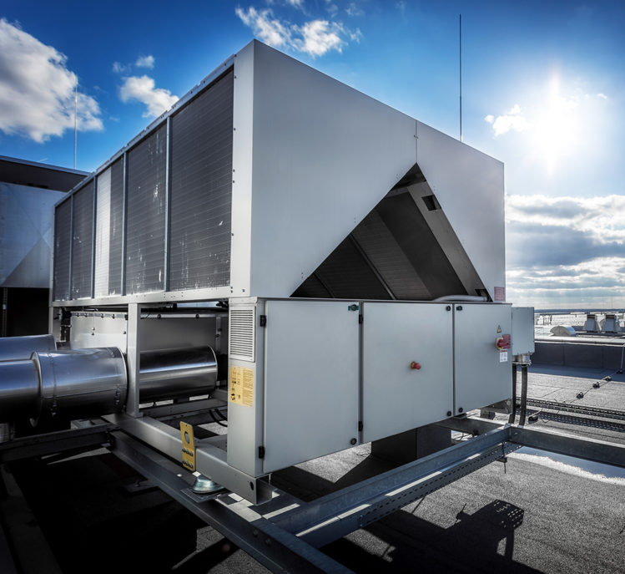
Notes:
Work as Head of Data Science at Soundsensing.
Soundsensing is a leading provider of predictive maintenance solutions for ventilation systems in buildings. So we work a lot with sensor data. And also use Python as much as we can for Data Science, IoT and backend tasks.

Slide 4
Goal of this talk
You as a scientist, or engineer supporting scientists,
become familiar with how to create custom sensor systems
using microcontrollers and (Micro)Python
including on-sensor data processing
like digital signal processing and machine learning
Outline
Wireless Sensor Networks
MicroPython
emlearn

Slide 5
Wireless Sensor Networks
for scientific applications

Slide 6
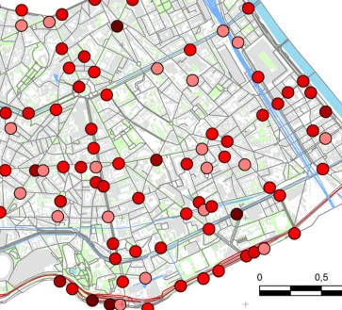
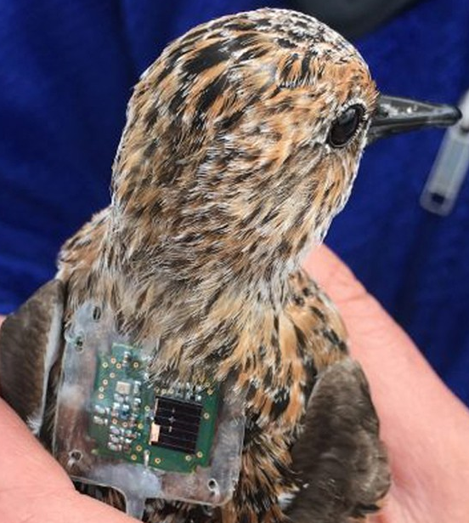
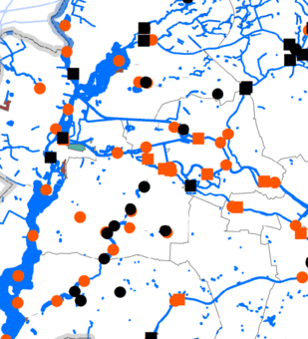
To understand the world, we must measure it
Urban Noise
Animal behavior
Hydrology
How:
Wireless communication
Battery powered
Microcontroller
Commodity sensors
Smart on-sensor processing
Want: Measurements over time Many measurement locations
Need: Low-cost, unattended, data transfer Sometimes: Small / portable
Notes:
This is a huge amount of applications for this, in basically any field that uses electronics.
Keyword spotting / wakeword detection. “Alexa” Smartwatch. Sleep activity tracking Agriculture. Cattle activity tracking Condition monitoring of Machinery.
Or what about a cat doorbell that only lets in your cat, and only if it does not have a prey in its both. Magic wand.

Slide 7

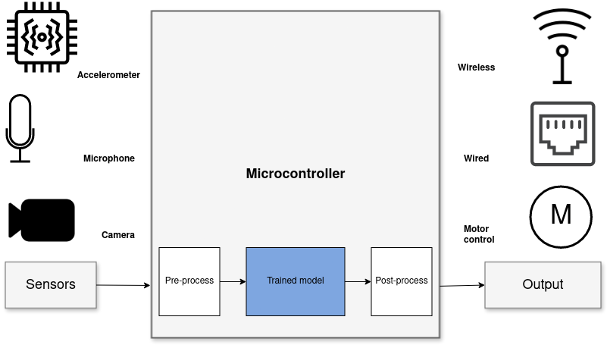
On-sensor data analysis with Machine Learning
Benefits vs sending data to cloud
Stand-alone
Low latency
Power efficiency
Privacy
Low cost
Focus of this talk
System diagram for “TinyML” solution
Notes:
When it comes to Machine Learning on microcontrollers,
we are obviously not going to be running any Large Language Models or generative image models.
But one usecase where ML is incredibly useful is in analysing sensor data.
Sensors such as accelerometers, microphonones, radars, and cameras have gotten incredibly cheap and powerful.
But in order to get useful information out of these, the raw data must be processed.
Using Machine Learning, in combination with Digital Signal Processing, allows analyzing complex phenomena.
If this is done on the microcontroller, we get a range of benefits:
...
The component in blue is the Machine Learning model, and is typically trained ahead of time on a PC.

Slide 8
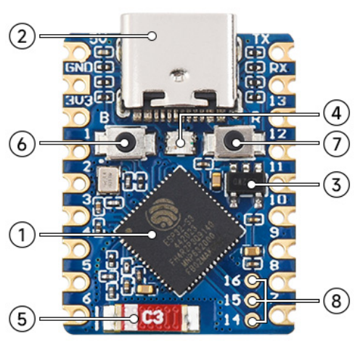
What is a microcontroller?
Modern microcontroller: A complete programmable System-on-Chip
Example: ESP32-S3FH4R2
32 bit CPU, 240 Mhz Floating Point Unit 2 MB RAM 4 MB FLASH
WiFi Bluetooth Low Energy
USB-C
Espressif ESP32-S3FH4R2 chip: 2.5 USD
Waveshare ESP32-S3-Tiny board: 6 USD

Slide 9
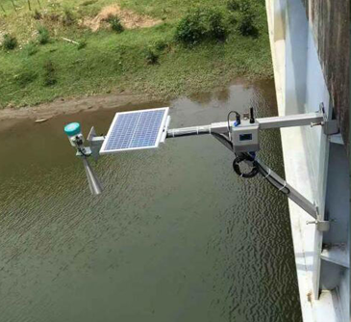
Slow-changing phenomena
For slow-changing phenomena (relative to measurement interval)
Sample, Send, Sleep
1. Read the sensor 2. Send data 3. Wait until next measurement
Processing
Sensor reading
Send
Water level measurement
Energy
Sleep zzzzZZZ
Time
Measurement interval
Active time
3 seconds
5 minutes
Notes:
Temperature is a slow changing phenomena. Want: 1 value for longish time interval (ex: 5 min)
! Sensor can be noisy. Filtering advised
Will show analog sensor example. Same approach can be used for a digital sensor. And for other slow-changing phenomena.

Slide 10
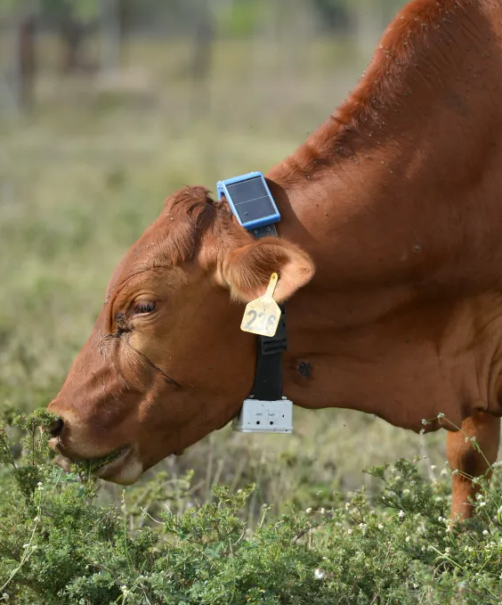
Continuous measurement
Health monitoring of cows using accelerometer
Processing
Sensor reading
Send accelerometer data continuously 6 kB bytes/minute
Send
Power Efficient Wireless Sensor Node through Edge Intelligence
Abhishek Damle (2022)
Classify data using a Decision Tree lying/walking/standing/grazing/ruminating 6 bytes / minute
Active time
Measurement interval

Slide 11
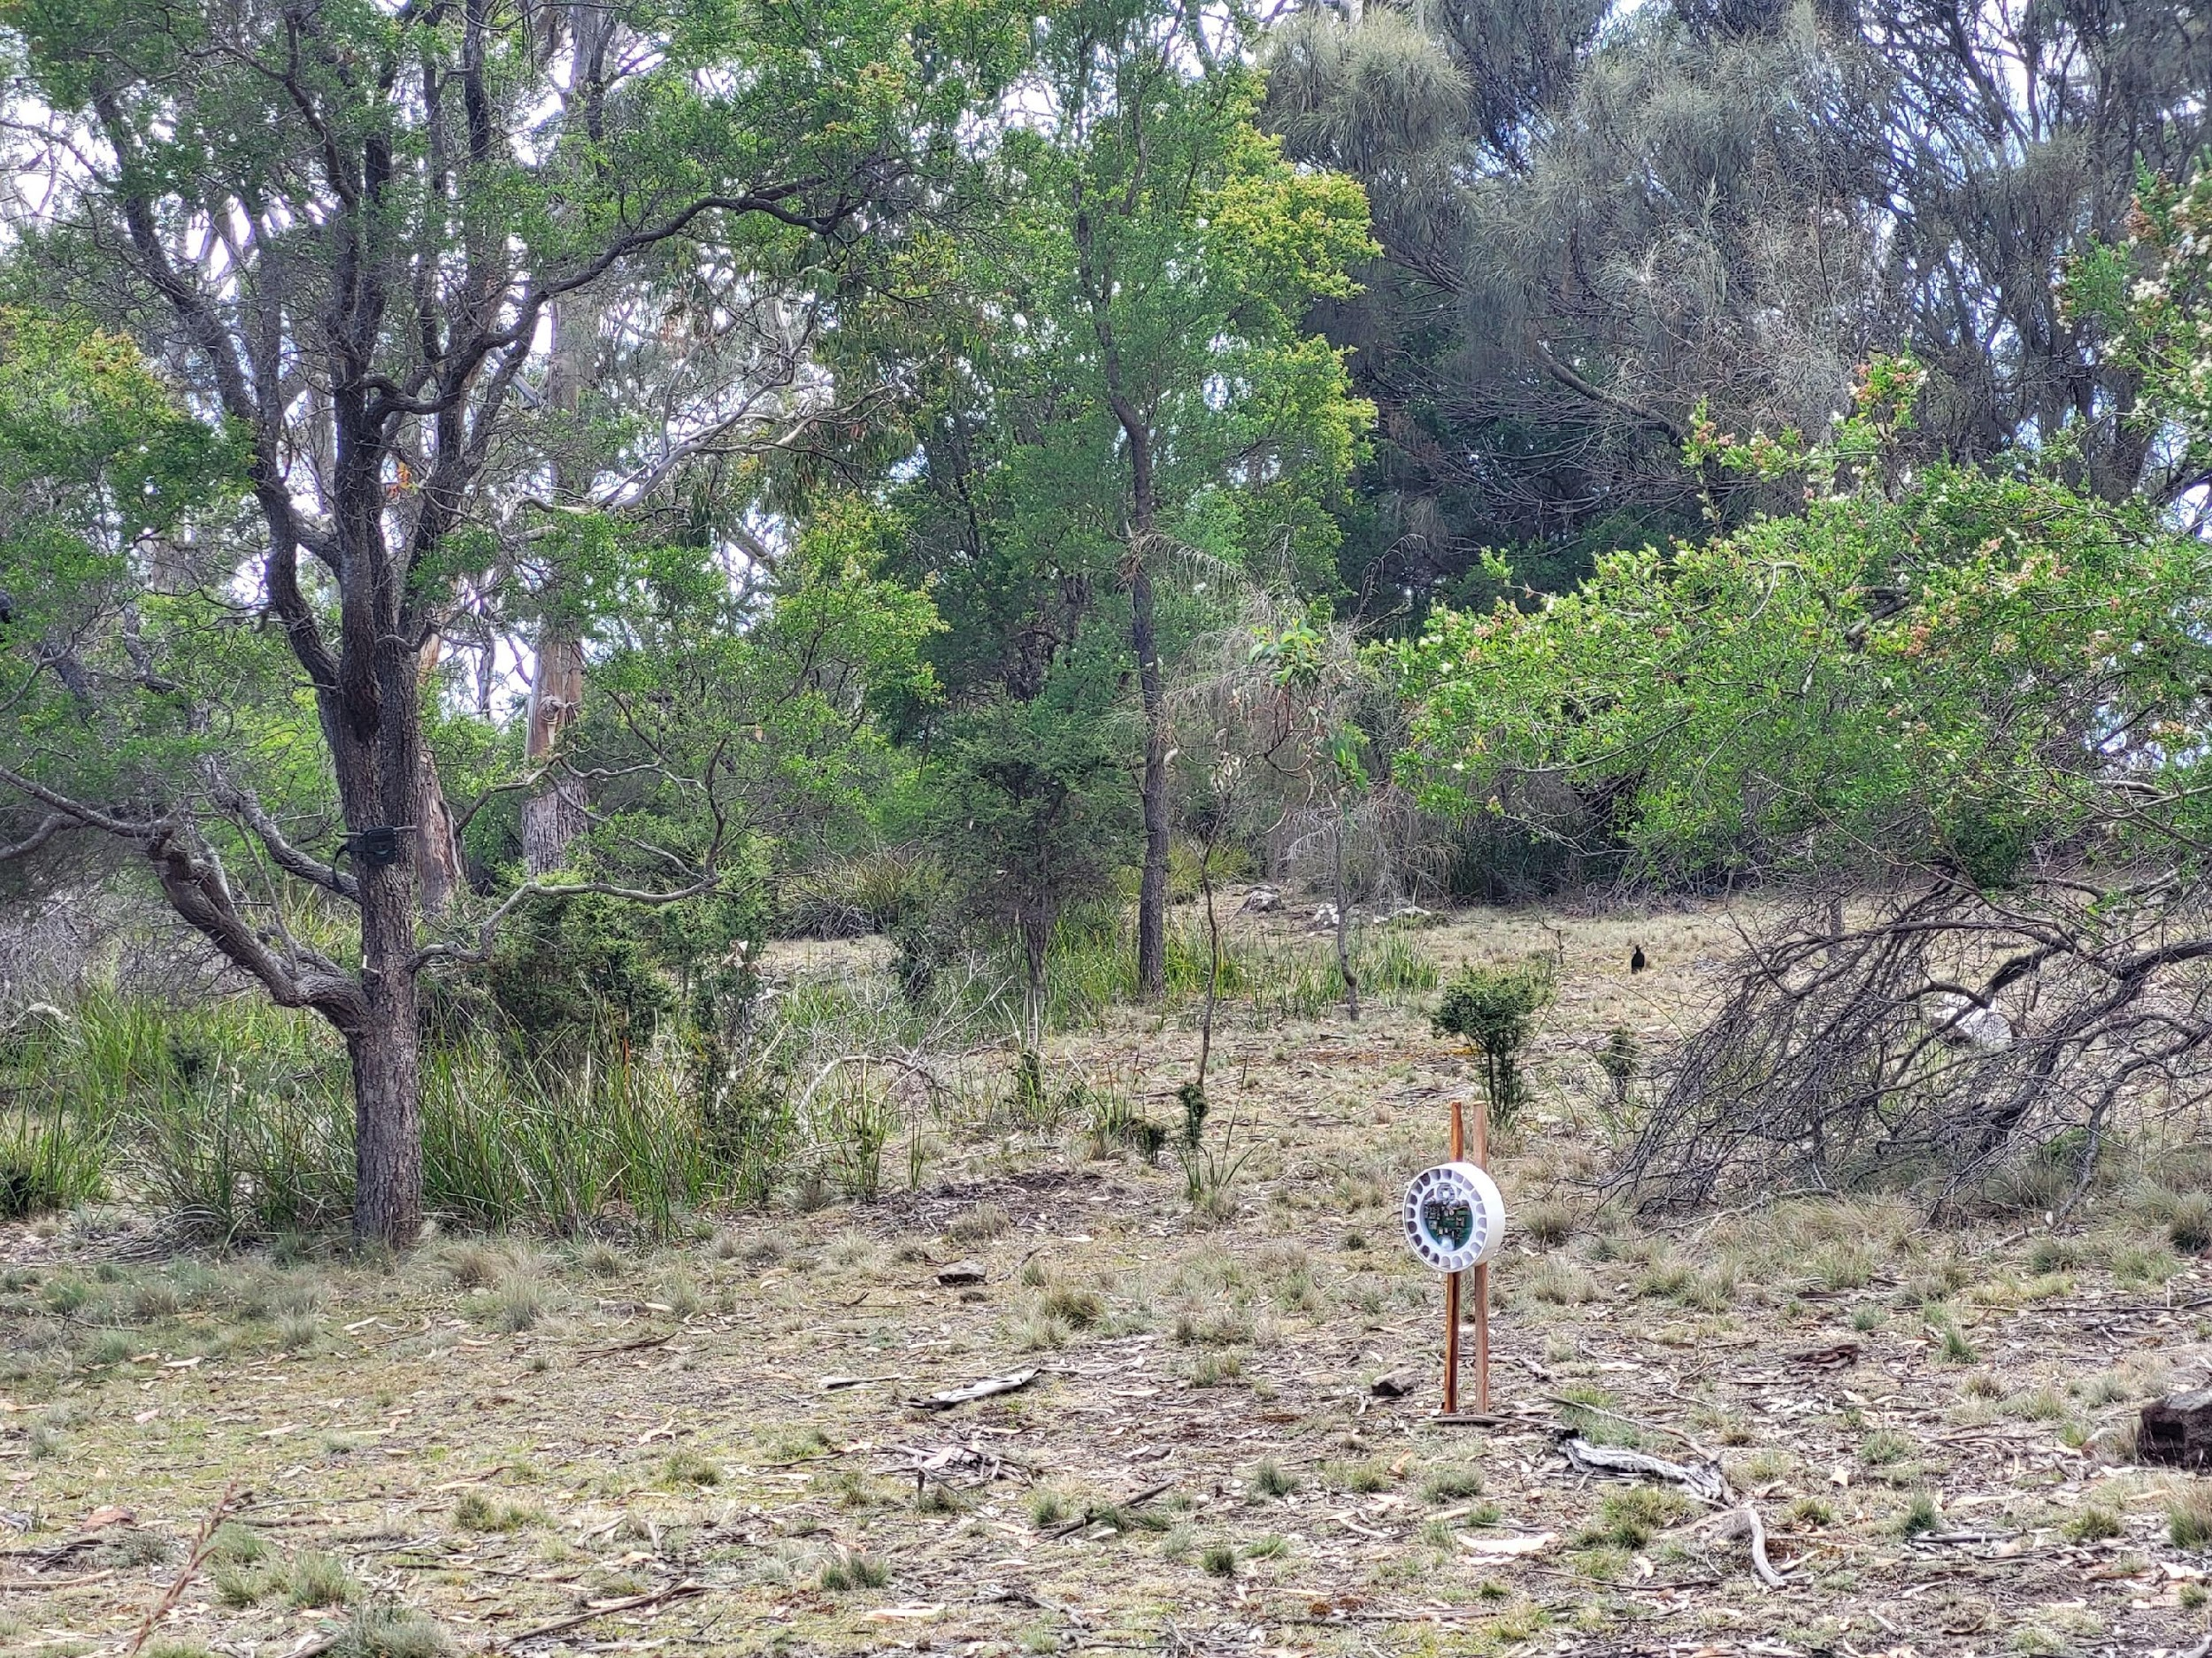
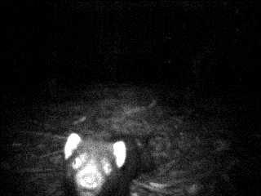


Act locally
Task: Give vaccinated bait only to Tasmanian devils
Trigger: PIR sensor
Wake up
Classify image using CNN if is_Taz: dispense_bait()
Send event over LoRaWAN
EdgeAI bait dispenser to vaccinate the Tasmanian devil (Sarcophilus harrisii) against the devil facial tumour disease Prithul Chaturvedi¹, Andrew S. Flies, et al.
Notes:
Make it moving again and again (loop it)

Slide 12
MicroPython tour

Slide 13
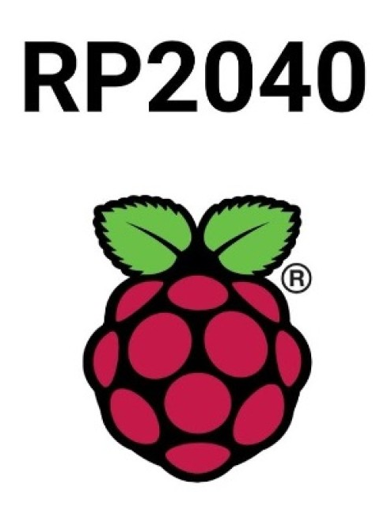

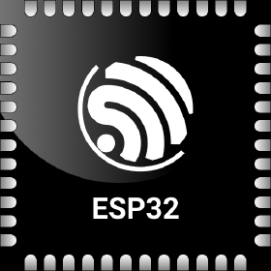

MicroPython - Introduction
Implements a subset of Python 3.x
For devices with 128 kB+ RAM Supports 8+ microcontroller families directly, many more via Zephyr RTOS
Official webpage: https://micropython.org
Notes:
STM32, Nordic NRF5x, ESP32, RP2040

Slide 14
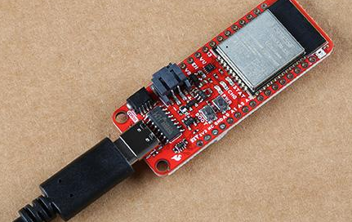
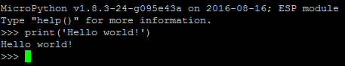
MicroPython - Installing
Download prebuilt firmware https://micropython.org/download/?port=esp32
Flash firmware to device
pip install esptool
esptool.py --chip esp32 --port … erase_flash
esptool.py --chip esp32 --port … write_flash -z 0 micropython-v1.17.bin
Connect to device
pip install mpremote mpremote repl
IDE (optional): Thonny, VS Code, et.c.
Notes:
! drives for peripherals that are on a board not included in core firmware
Will likely need to hunt a bit for each sensor, screen etc

Slide 15
MicroPython is Python - but not CPython
High degree of compatibility - but never 100% Continuous job to keep up with CPython Some differences inherent - from < 1 MB RAM and FLASH Included libraries are minimal micropython-lib has more extensive/featured https://github.com/micropython/micropython-lib
Known incompatibilities https://docs.micropython.org/en/latest/genrst/index.html #micropython-differences-from-cpython Not implemented (by CPython major release) https://github.com/micropython/micropython/issues/ 7919#issuecomment-1025221807
No CFFI or C module compatibility! But there is another C API
=> No standard PyData stack
But there are alternatives
Notes:
Temperature is a slow changing phenomena. Want: 1 value for longish time interval (ex: 5 min)
! Sensor can be noisy. Filtering advised
Will show analog sensor example. Same approach can be used for a digital sensor. And for other slow-changing phenomena.

Slide 16
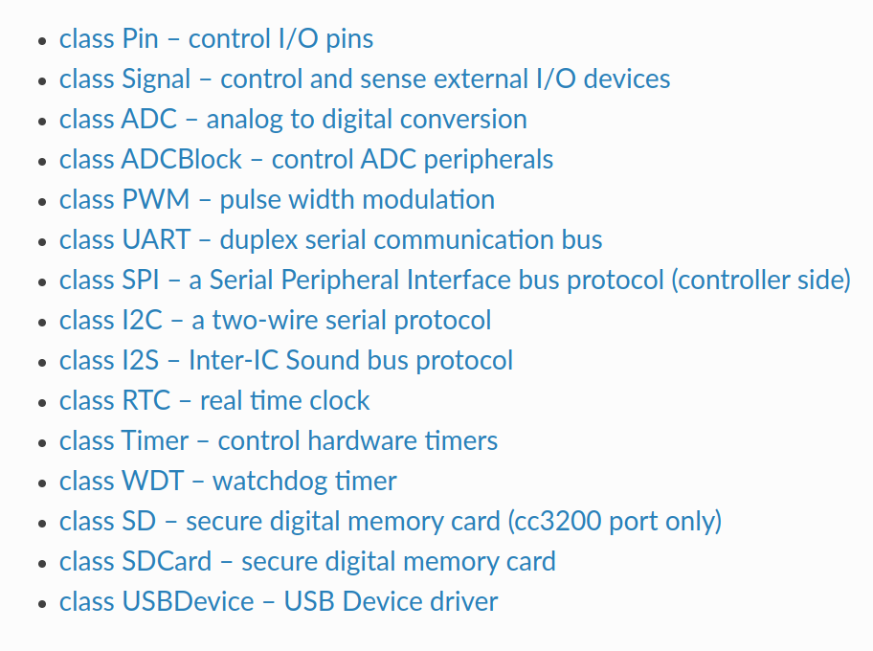
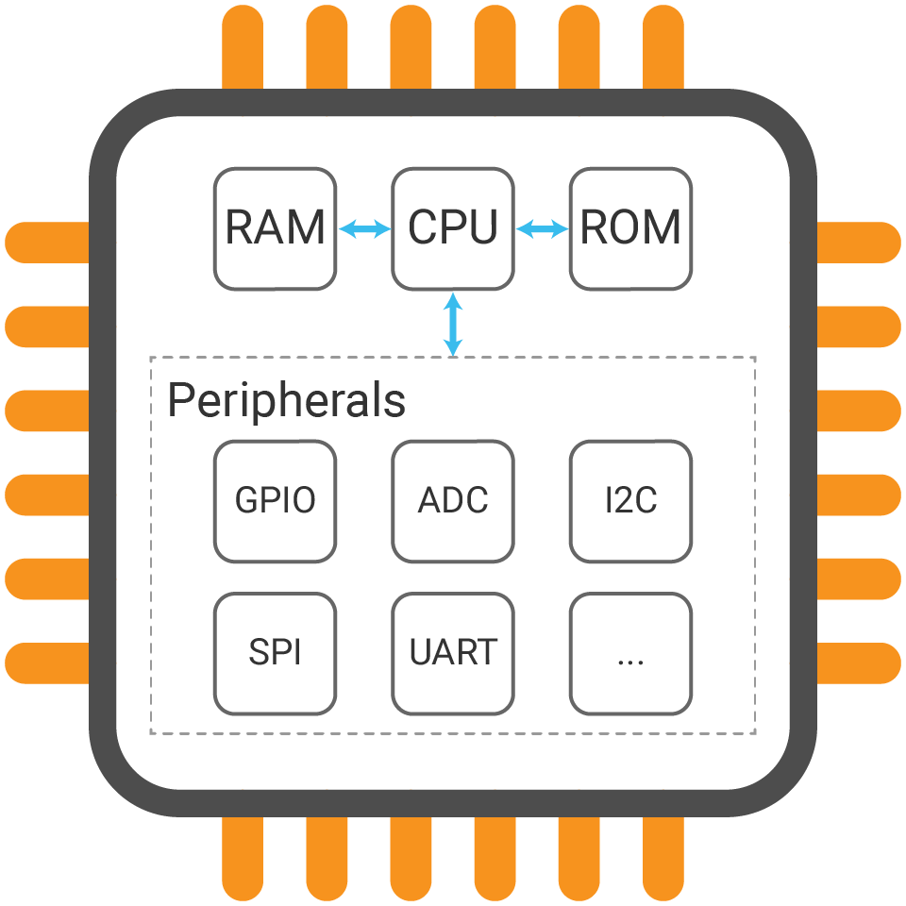
Hardware access - the machine module
https://docs.micropython.org/en/latest/library/machine.html
Hardware Abstraction Layer for microcontroller peripherals
Same on all hardware/ports * with exceptions

Slide 17





Connectivity
WiFi network.WLAN Ethernet network.LAN
BLE - Bluetooth Low Energy aioble - high-level application API, asyncio bluetooth - low-level hardware-layer
Cellular (4G / LTE) network.PPP LoRa / LoRaWAN micropython-lib: lora
Notes:
Temperature is a slow changing phenomena. Want: 1 value for longish time interval (ex: 5 min)
! Sensor can be noisy. Filtering advised
Will show analog sensor example. Same approach can be used for a digital sensor. And for other slow-changing phenomena.

Slide 18
mpremote
File system
Enabled on most ports/hardware (with sufficient resources)
Internal FLASH and/or SDCard
LittleFS or FAT32
Save/load from standard files [1] https://docs.micropython.org /en/latest/reference/filesystem.html
Tool for PC <-> microcontroller communication https://docs.micropython.org /en/latest/reference/mpremote.html
Copy from device mpremote cp -r :images/ ./data/
Copy to device mpremote cp ./model.trees.csv ./models/
1. Using micropython-npyfile to read/write Numpy .npy files https://github.com/jonnor/micropython-npyfile/
Notes:
Temperature is a slow changing phenomena. Want: 1 value for longish time interval (ex: 5 min)
! Sensor can be noisy. Filtering advised
Will show analog sensor example. Same approach can be used for a digital sensor. And for other slow-changing phenomena.

Slide 19
mip - package manager
Install from micropython-lib
mpremote install requests Third party packages
mpremote install github:jonnor/micropython-zipfile Can run directly on device [1]
import mip mip.install(‘requests’)
Install native C modules at runtime
mpremote mip install https://example.net/ xtensawin_6.2*/emlearn_trees.mpy
1. Assuming device has Internet over WiFi/Ethernet
* Specify architecture + MicroPython ABI version
Notes:
Has support for loading C modules at runtime!

Slide 20
Efficient data processing in MicroPython
Specialized code emitters - numba.jit style
@micropython.native / @viper https://docs.micropython.org/en/latest/reference/speed_python.html #the-native-code-emitter
Inline assembler https://docs.micropython.org/en/latest/pyboard/tutorial/assembler.html
C modules https://docs.micropython.org/en/latest/develop/cmodules.html https://docs.micropython.org/en/latest/develop/natmod.html
PyData ZA 2024 Sensor data processing on microcontrollers with MicroPython https://www.youtube.com/watch?v=vBiji9IFJJs https://za.pycon.org/talks/31-sensor-data-processing-on-microcontrollers-with-micropython/

Slide 21
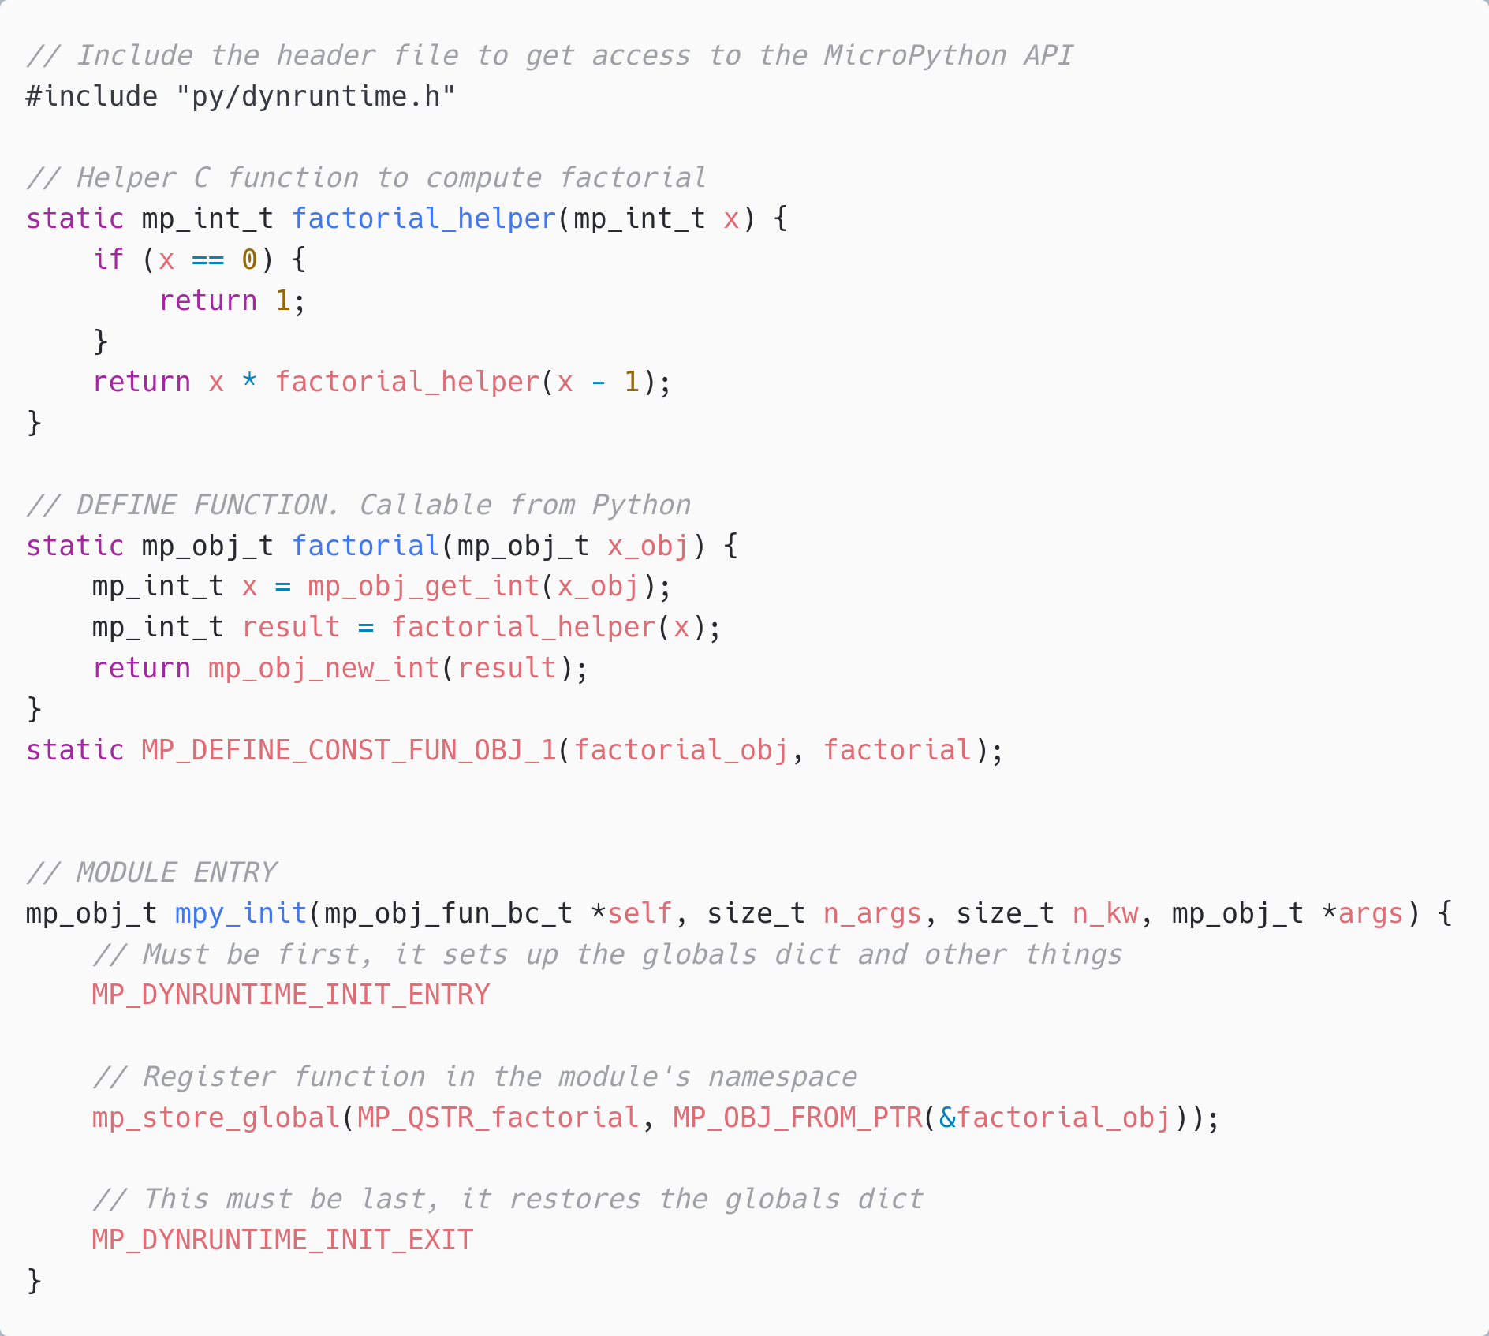
C modules *
Defines a Python module with API. functions/classes et.c.
Implemented by users, libraries, or part of MicroPython core.
Can be portable or hardware/platform specific
* Or other language which compiles to C, or exposes a C API. C++, Rust, et.c.

Slide 22
MicroPython Data Science ecosystem
CPython
MicroPython
Tensorflow
scikit-learn
emlearn-micropython
github.com/emlearn/emlearn-micropython
OpenCV
OpenMV
https://openmv.io/
scipy
ulab
github.com/v923z/micropython-ulab
numpy
Libraries existing that implement a lot of embedded-relevant functionality from PyData stack.

Slide 23
emlearn for MicroPython
Python is the lingua franca for Machine Learning How can we enable people to build microcontroller-grade machine learning using Python?
For easier learning and prototyping

Slide 24

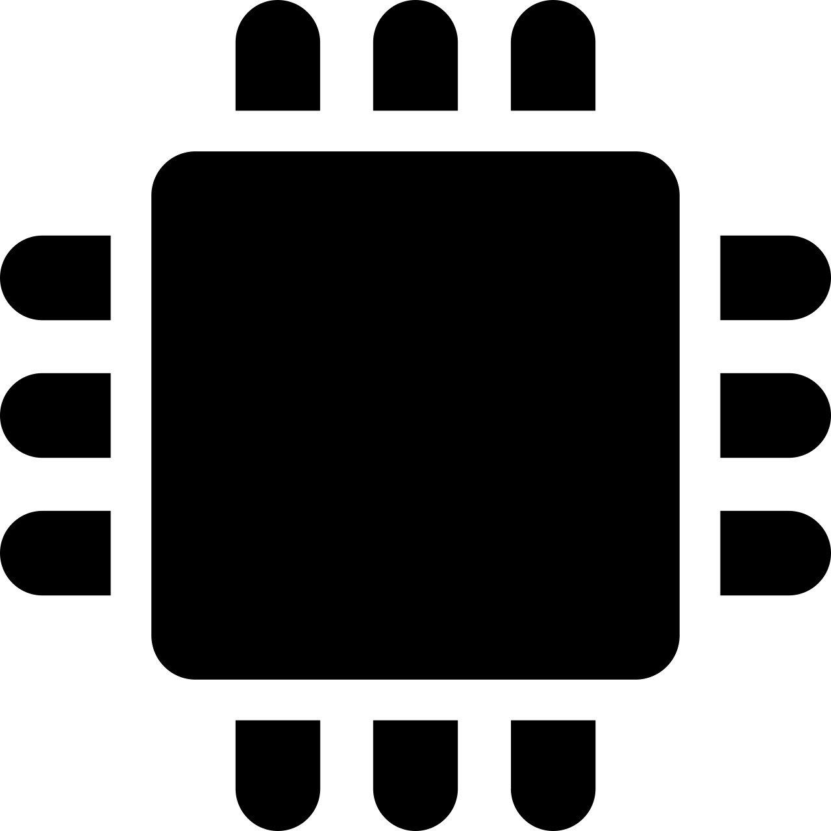




TinyML challenge: PC/host vs embedded/device pipeline
1) Train model on PC
2) Run on Device
Data
Sensor
RAM (min)
10 GB+
Translate
RAM (max): 1 MB
Pre-process
Pre-process
Model conversion tools
ML model
ML model
Translate
Embedded optimized pipeline
Deep-learning pipeline
Post-process
Post-process
Challenges
Very different constraints in the two environments
The two pipelines must be 100% compatible
Pre- and post-processing often application-specific, Turing complete
Different languages, tools, libraries, cultures
“Data Scientist land”
“Firmware Engineer land”

Slide 25
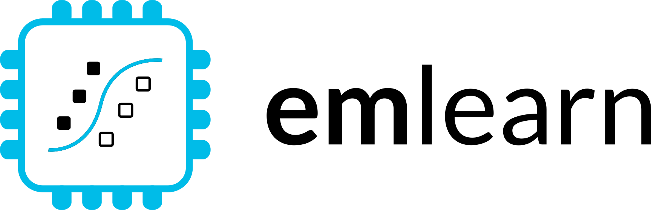







1. Train on PC
2. Deploy on device
pip install emlearn
Embedded Friendly
Portable C99 code
No dynamic allocations
Header-only
High test coverage
Integer/fixed-point math *
Small. 2 kB+ FLASH
Convenient training
Model creation in Python
Use standard libraries
scikit-learn
Keras
One-line to export to device
Verification tools included
Convenient & Efficient
Portable MicroPython
Single .mpy file
No dynamic allocations
High test coverage
Integer/fixed-point math *
Small. 2 kB+ FLASH
Notes:
emlearn is an open-source software library that can be used to implement such projects.
It provides embedded friendly implementations of Machine Learning models.
It supports converting models trained in Python.
Can either use scikit-learn or Keras.
The code is portable and clean C99.
It can be used on even the smallest MCUs,
as it does not need FPU, and the code size is very small.

Slide 26
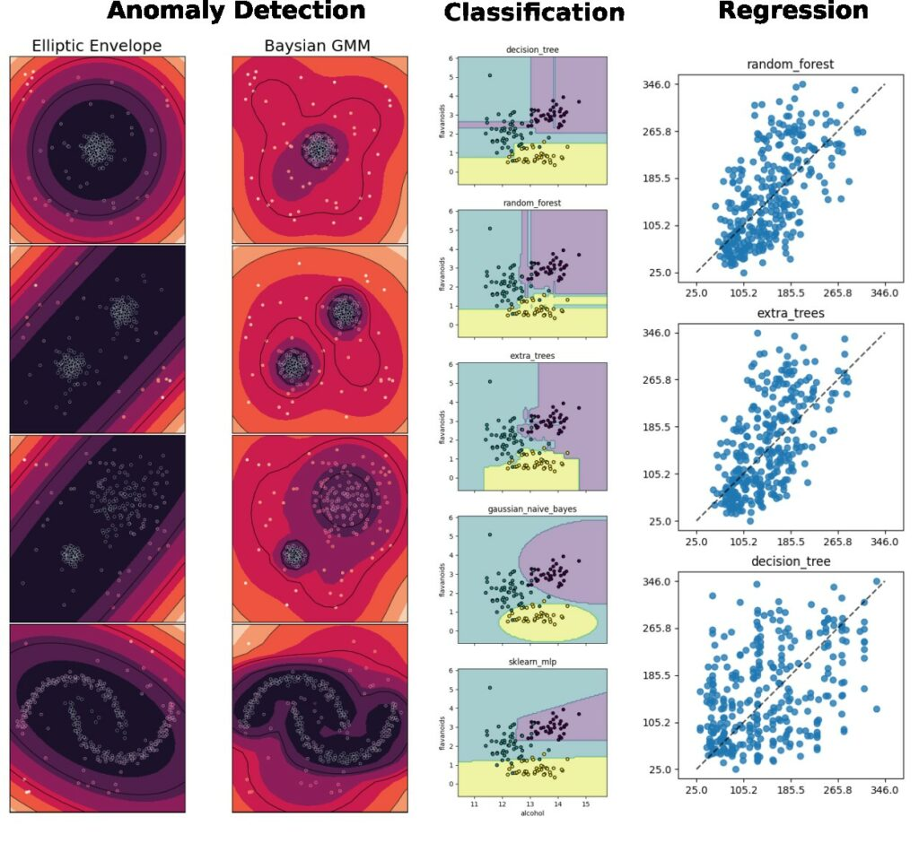
Supported tasks
Supports the most common tasks for embedded & sensor data use cases.
Classification
Regression
Anomaly Detection
Notes:
emlearn supports the three most common ML tasks:
classification, regression, anomaly detection.

Slide 27
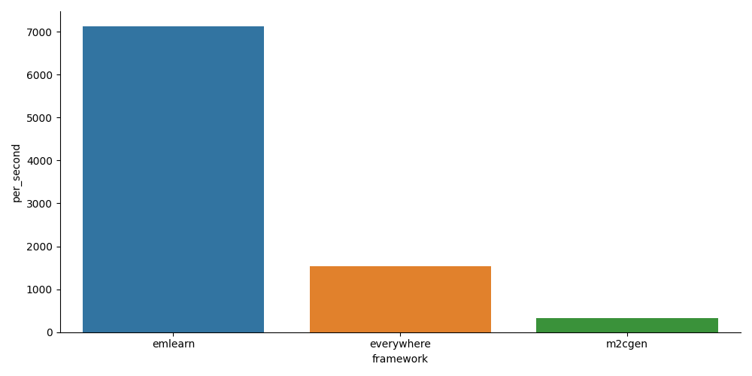
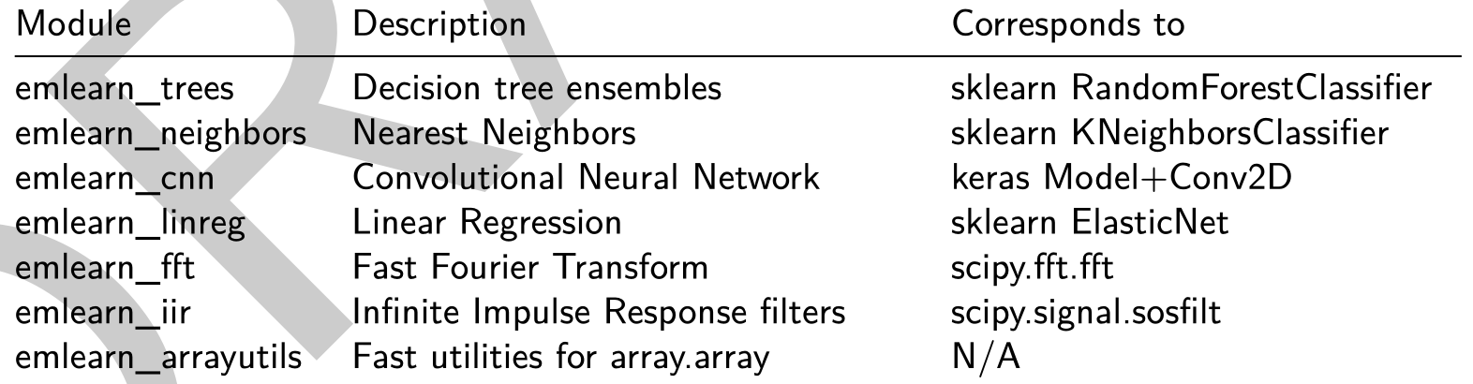
emlearn-micropython: MicroPython bindings for emlearn
https://github.com/emlearn/emlearn-micropython/
5x - 20x faster than plain Python
Modules installable at runtime (.mpy)
1 - 10 kB in size
PyData friendly

Slide 28
emlearn-micropython: Install & Export model
import emlearn
estimator = train_model()
converted = emlearn.convert(estimator)
converted.save(name='gesture', format=’csv’, file='gesture_model.csv')
Export model on PC
Copy model to device
mpremote fs cp gesture_model.csv :
Install MicroPython library on device
mip install https://emlearn.github.io/...../xtensawin_6.2/emltrees.mpy
Prebuilt binary No need to setup C toolchain and SDK

Slide 29
emlearn-micropython: Load model & run
import emltrees
# Instantiate model. Capacity for trees, decision nodes, classes
model = emltrees.new(20, 200, 10)
# Load model "weights"
with open('gesture_model.csv') as f:
emltrees.load_model(model, f)
Load model on device
# Read sensor data
sensor.fifo_read(samples)
# Preprocess features
preprocessor.run(samples, features)
# Run model
out = model.predict(features)
Run inference

Slide 30
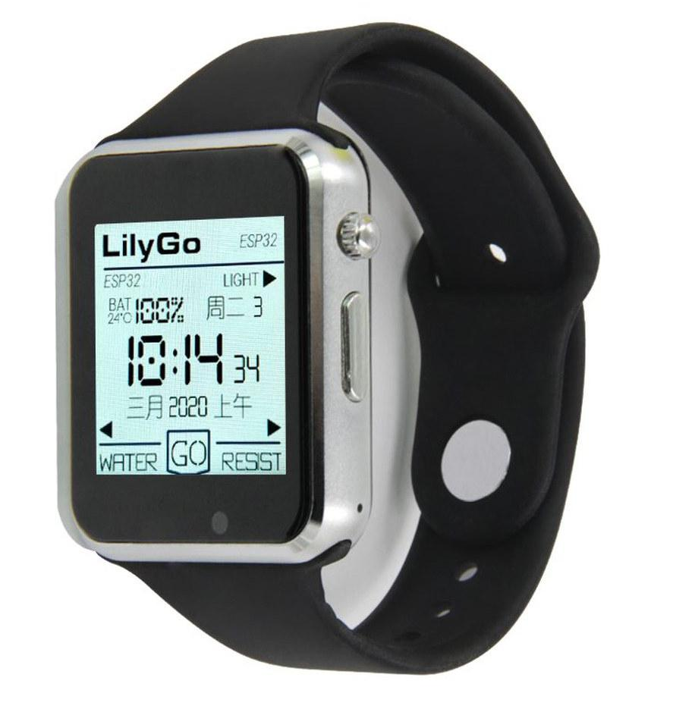
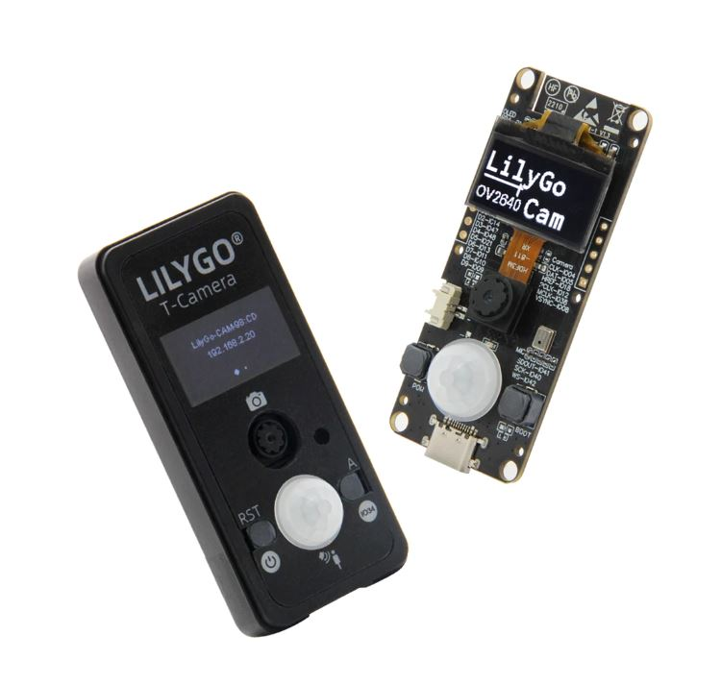
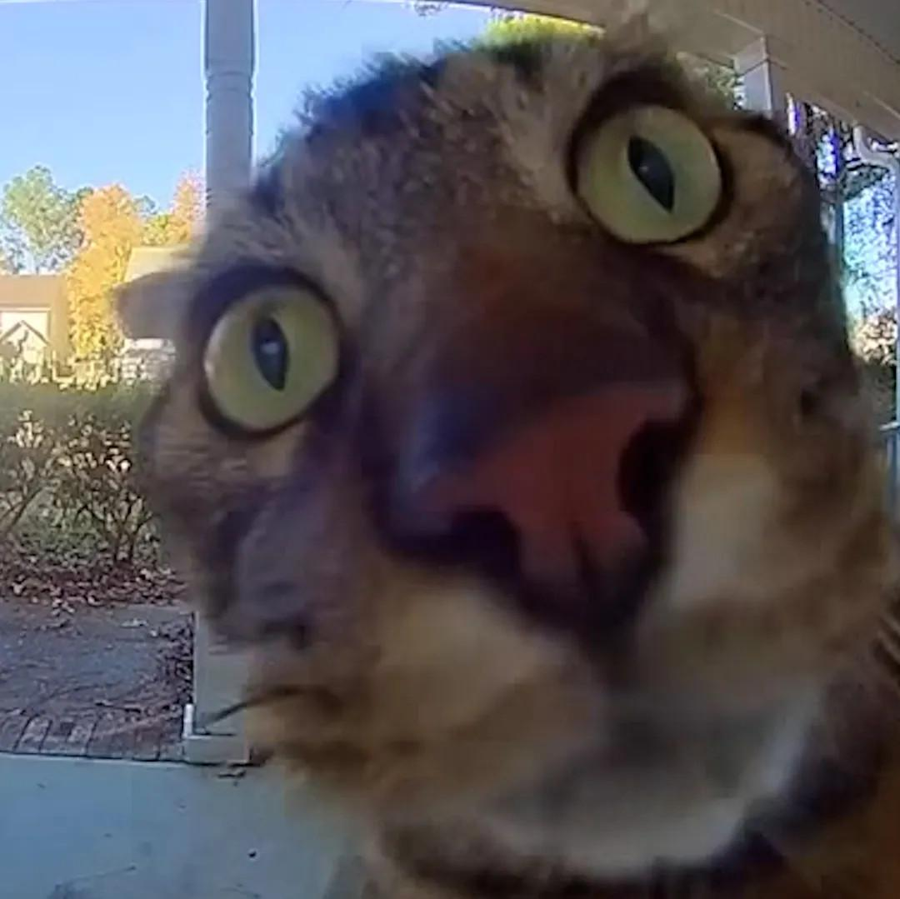
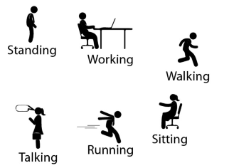
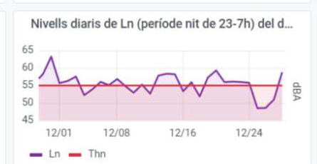
Activity tracker
Noise monitor
Image
Classifier
Accelerometer
Microphone
Camera
Examples at
https://github.com /emlearn/emlearn-micropython #examples
if is_MyCat(img): open_door()
Random Forest classifier emlearn_trees
Infinite Impulse Response filters emlearn_iir
Convolutional Neural Network emlearn_cnn

Slide 31
Outro

Slide 32
Summary
Many scientific applications rely on collecting a lot of physical data
Large deployments possible with low-cost Wireless Sensor Networks
Sensor nodes can be developed in Python, using MicroPython on microcontroller
MicroPython has good tools for sensor data processing,
including connectivity, storage, performance
Good ecosystem for data processing,
including machine learning with emlearn-micropython
Notes:
Inline and loadable (data structure) Majority voting instead of class probabilities Leaf-node de-duplication

Slide 33
Sprint MicroPython / emlearn
On Friday!

Slide 34
Sensor data processing on microcontrollers with MicroPython
https://github.com/emlearn/emlearn-micropython
Jon Nordby <jononor@gmail.com> EuroSciPy, Krakow, August 2025

Slide 35
Bonus

Slide 36
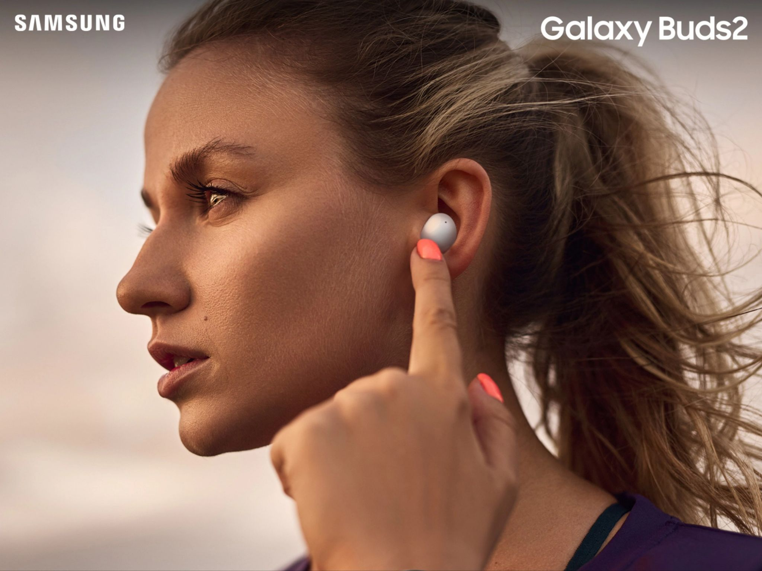
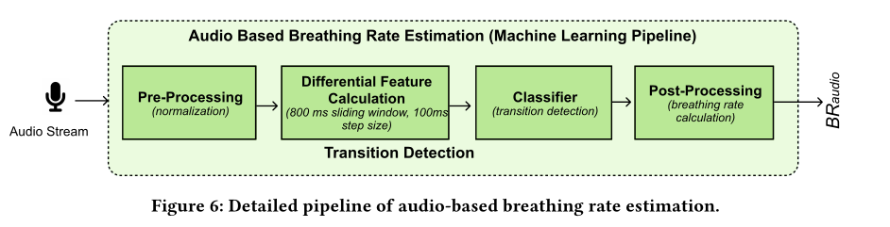
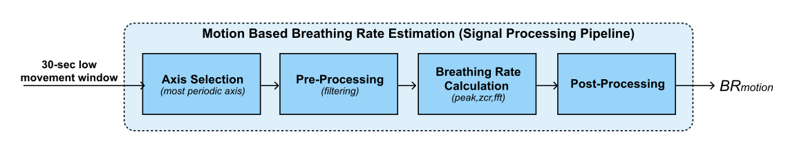
Health monitoring earable
Breathing rate is critical to monitor for persons with respiratory health problems.
Monitoring for every-day use, not just in clinical context. Using earable to replace specialized devices.
Random Forest classifier for audio.
Remote Breathing Rate Tracking in Stationary Position
Using the Motion and Acoustic Sensors of Earables
Tousif Ahmed et.al (2023)
Notes:
The project was started in 2018 by me.
And has been maintained by me since that time. With a couple of contributors here and there. Quite mature. Has been used for dozens of projects across the world.

Slide 37
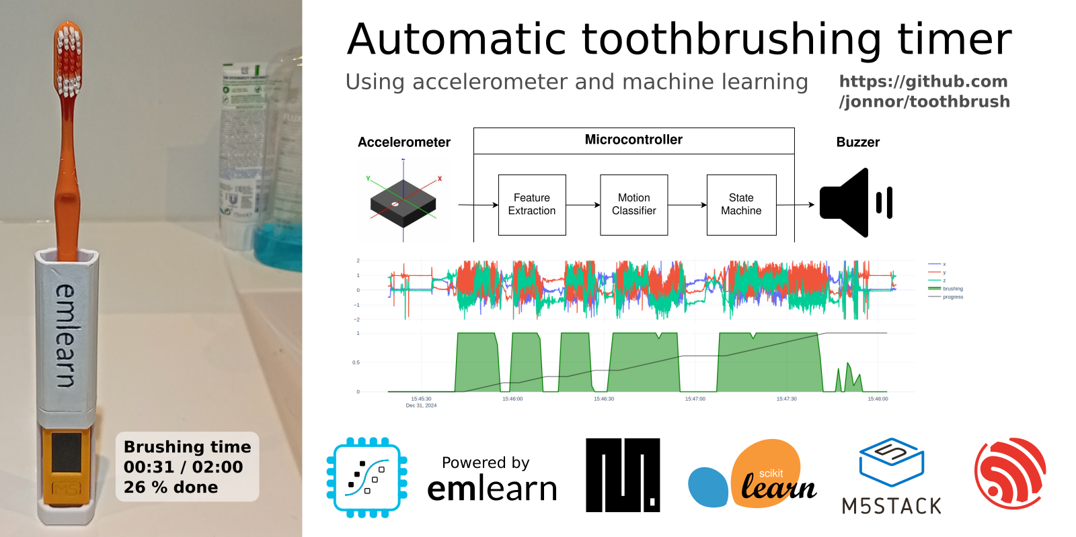
Automatic toothbrush timer
https://github.com/ jonnor/toothbrush/
Stock hardware: M5StickC PLUS 2 by M5Stack
~500 lines of MicroPython code
Collected and labeled data in ~1 hour
Data collection and training tools: https://github.com/emlearn/emlearn-micropython/tree/master/examples/har_trees

Slide 38

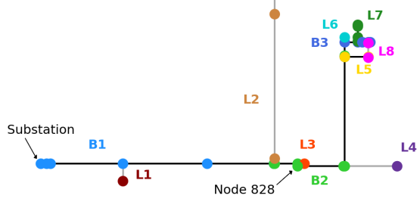
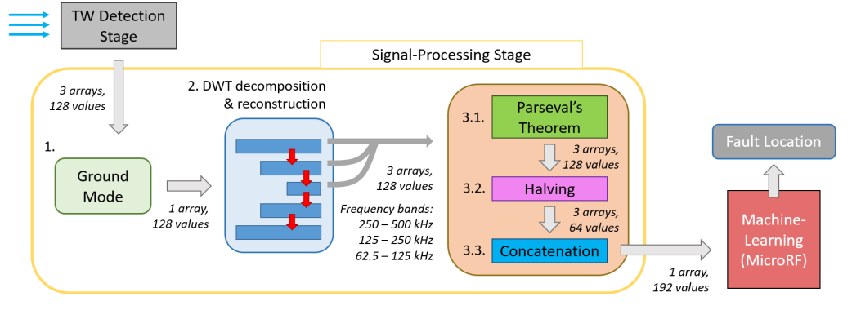

Electric grid monitoring
Detect and localize faults in the electric grid.
Analyzes the voltage signals at a single location.
Able to detect where the fault originated.
Runs on a DSP board from Texas Instruments.
Micro Random Forest: A Local, High-Speed Implementation of a Machine-Learning Fault Location Method for Distribution Power Systems
Tousif Ahmed et.al (2023)
Notes:
The project was started in 2018 by me.
And has been maintained by me since that time. With a couple of contributors here and there. Quite mature. Has been used for dozens of projects across the world.

Slide 39
Misc

Slide 40
Model optimization
https://emlearn.readthedocs.io/en/latest/model_optimization.html
https://emlearn.readthedocs.io/en/latest/tree_based_models.html

Slide 41
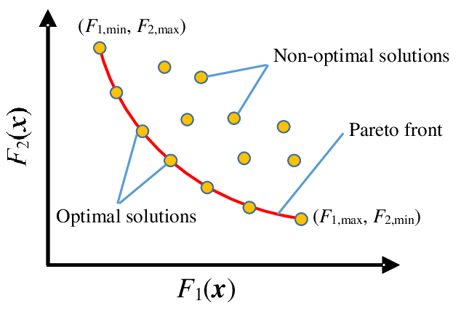
Pareto front - performance/compute tradeoffs
Many possible combinations of predictive performance vs computational cost
No point considering the non-optimal solutions!
Pareto front is formed by the set of optimal solutions - that dominate the non-optimal ones
Describes the possible tradeoffs between predictive performance and compute
Utilities for finding Pareto front in emlearn.evaluate.pareto https://emlearn.readthedocs.io/en/latest/evaluate.html Example: https://emlearn.readthedocs.io/en/latest/auto_examples/trees_hyperparameters.html
Notes:
Inline and loadable (data structure) Majority voting instead of class probabilities Leaf-node de-duplication

Slide 42
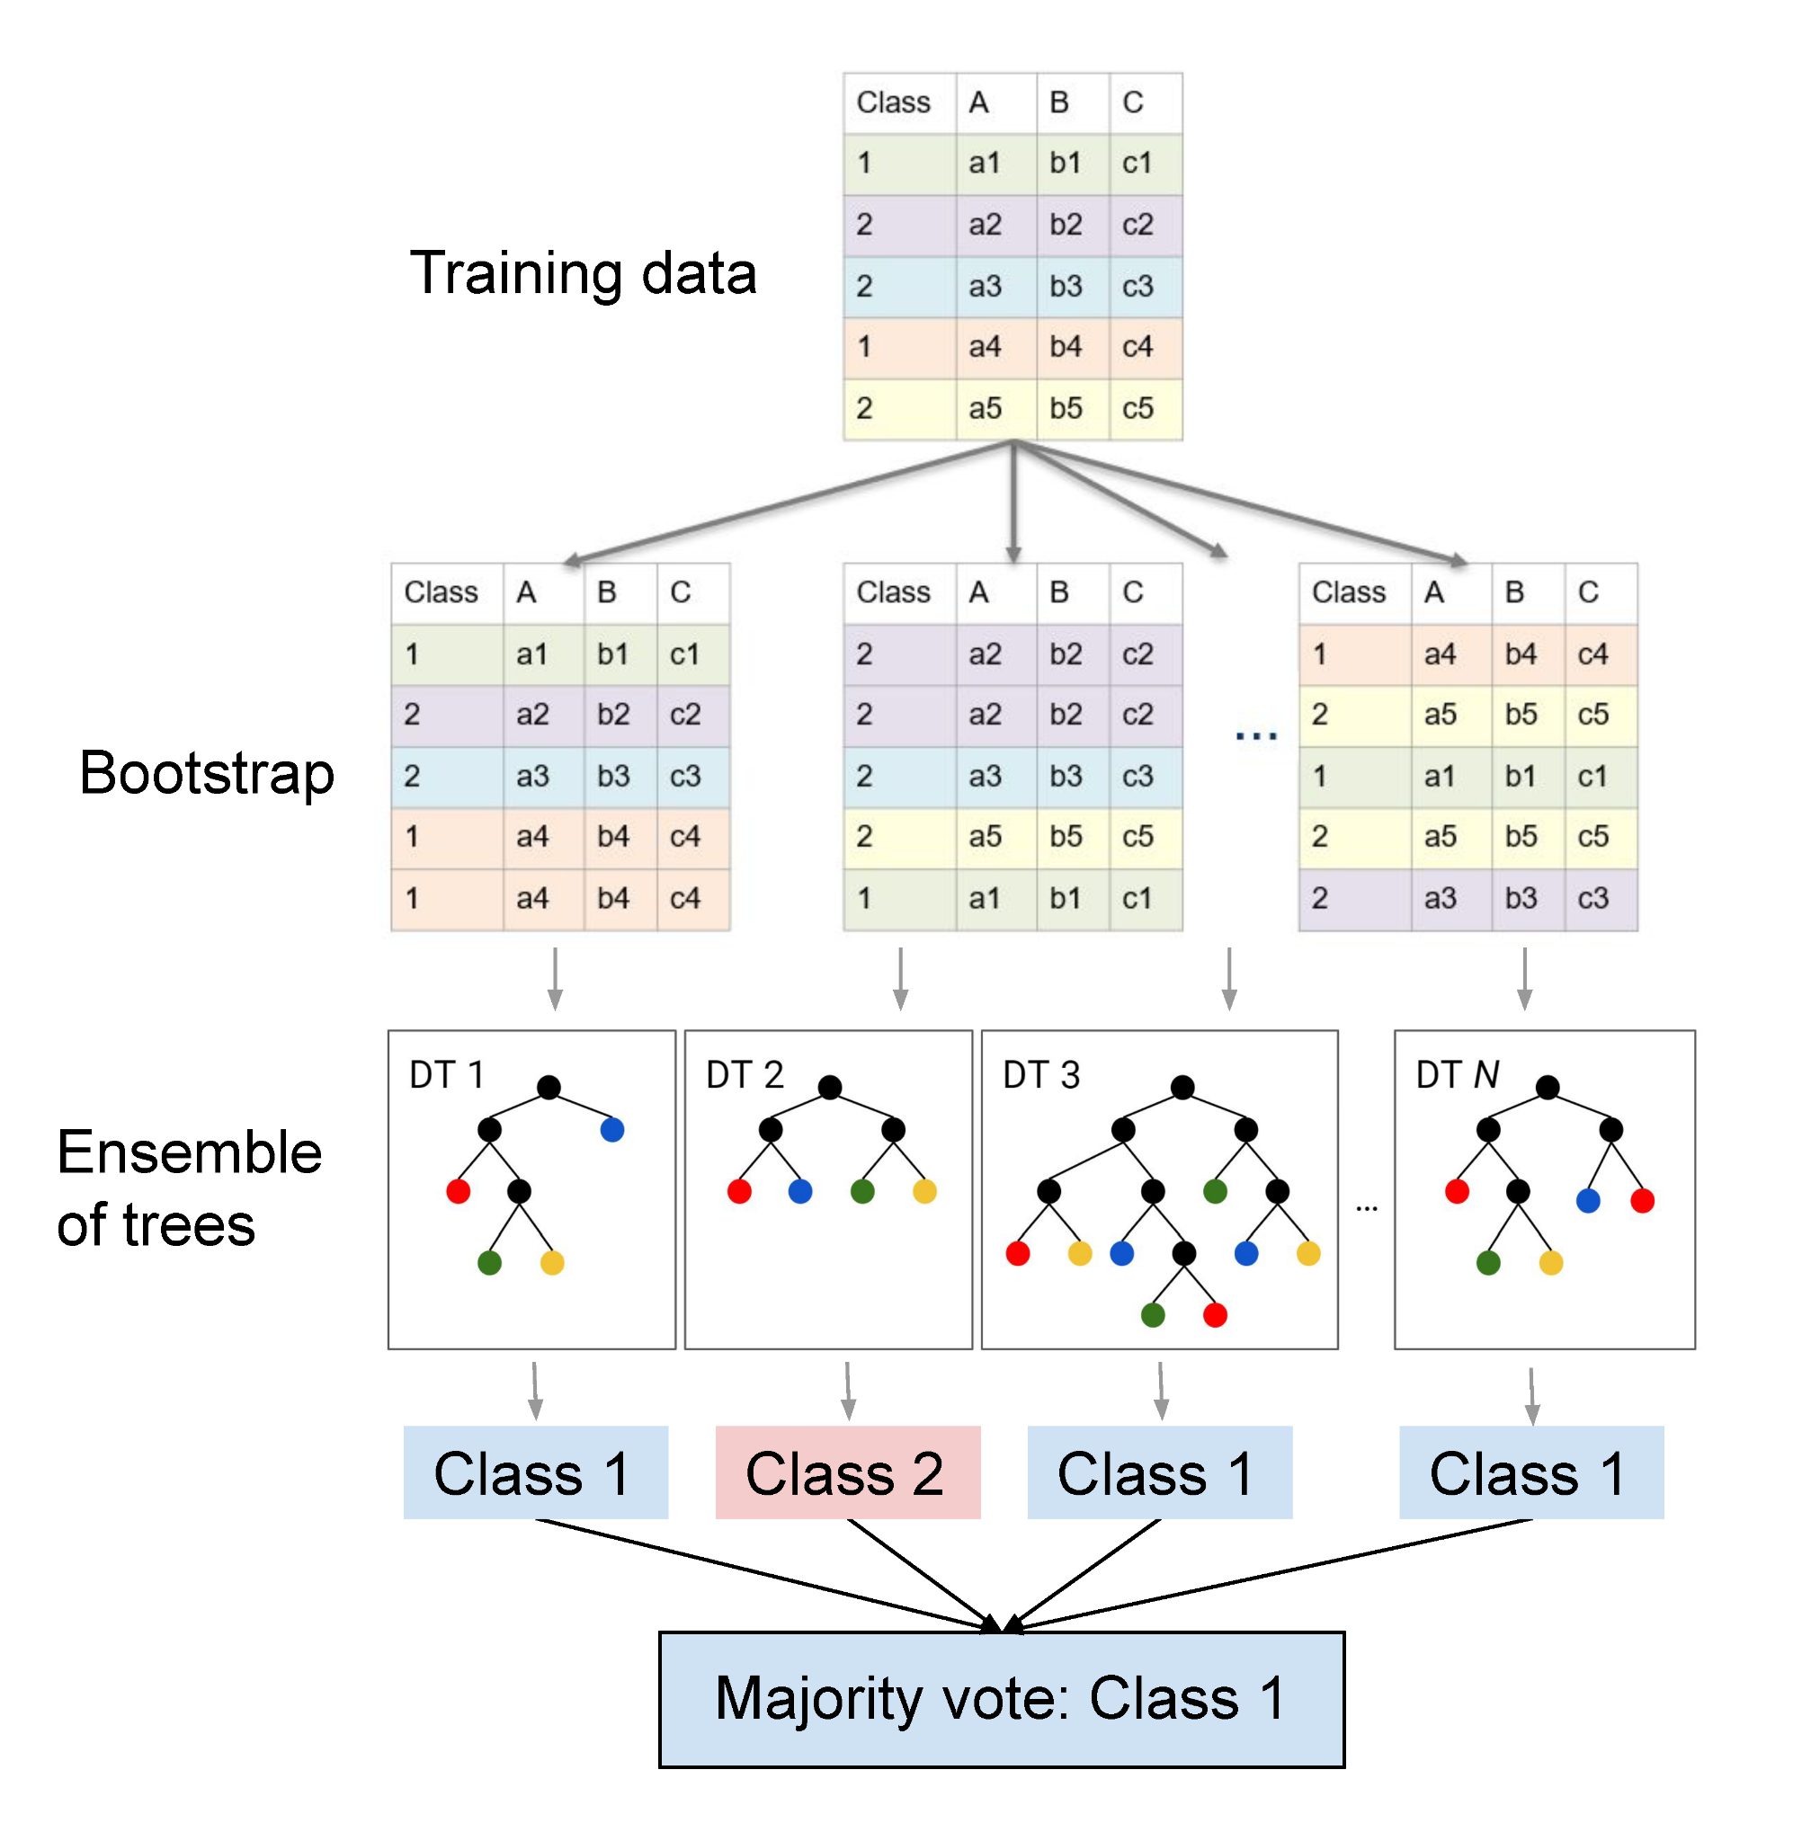
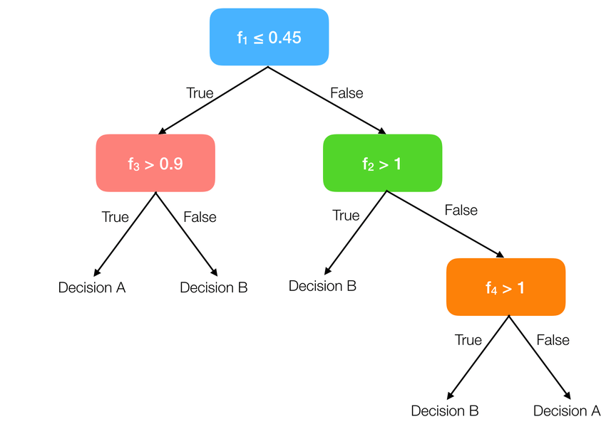
How tree-ensemble models work

Slide 43
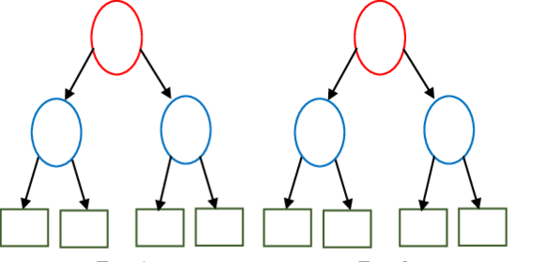
Tree-based ensembles - costs
Input features, length F [ 0.23, 0.56, 0.11, 0.55 ]
IF features[2] < 0.74 THEN next=left ELSE next=right
Depth D
Tree 1
Tree 2
No. features F [0]
No. trees T
Tree Depth D_max [1] / D_eff [2]
No. nodes N ≈ T * (2 ** D)
Computational costs
Memory (RAM) O(F)
Program (FLASH) O(N) [3]
Exc. time (CPU) sum(D_eff(t), t -> T)
[0] May also enable deeper trees
[1] Depth might differ across trees [2] Execution path is data dependent! Can estimate average using a dataset, or worst-case from model [3] Assuming leaf and decision nodes same size
cl1
cl2
Utilities for estimating costs
from emlearn.evaluate.trees import model_size_bytes, compute_cost_estimate
Notes:
Inline and loadable (data structure) Majority voting instead of class probabilities Leaf-node de-duplication

Slide 44
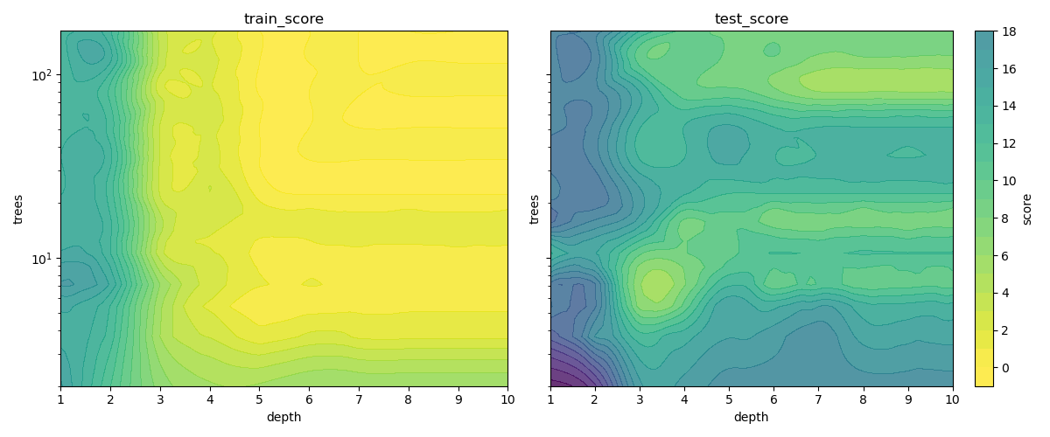
Tree-based ensemble - predictive performance
No. features F increases capacity
No. trees T increases capacity, decreases overfitting
Tree Depth D_max / D_eff increases capacity, increases overfitting
No. nodes N ≈ T * D
For generalized performance (on unseen data), need to balance overfitting.
Notes:
Inline and loadable (data structure) Majority voting instead of class probabilities Leaf-node de-duplication

Slide 45
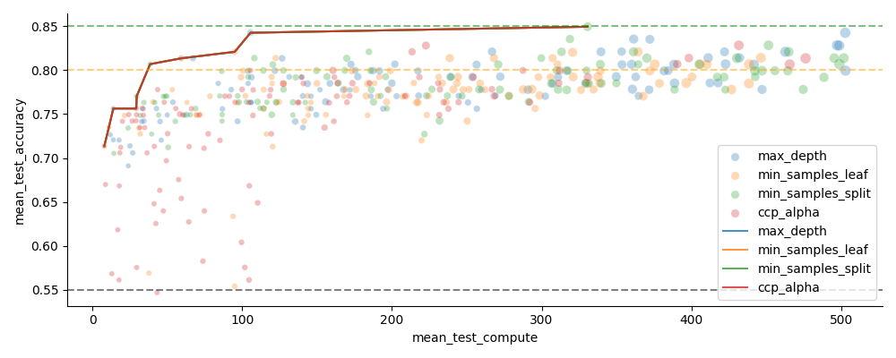
Hyperparameter tuning with scikit-learn
Vary n_estimators (trees) and one of the depth limiting hyperparameters
from sklearn.model_selection import GridSearchCV, RandomizedSearchCV
https://emlearn.readthedocs.io/en/latest/auto_examples/trees_hyperparameters.html
Notes:
Inline and loadable (data structure) Majority voting instead of class probabilities Leaf-node de-duplication

Slide 46
Activity Recognition
Using accelerometer / IMU

Slide 47
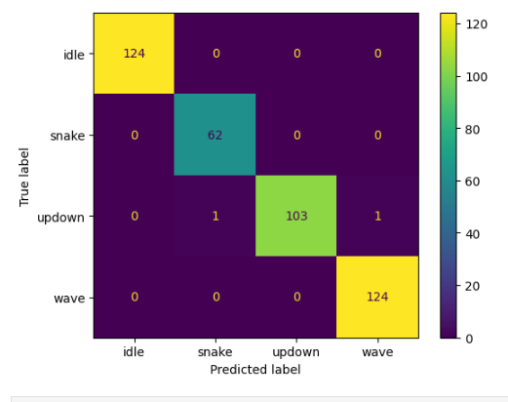
Training a RandomForest model
Standard process - familiar to anyone who has used scikit-learn.
But - Make sure model size is not huge.
# preprocess data
windows = train.groupby(....).apply(create_windows, length=int(2000/15), hop=int(260/16))
features = windows.groupby(...).apply(spectral_features)
# train model
from sklearn.ensemble import RandomForestClassifier
est = RandomForestClassifier(n_estimators=10, max_depth=5)
est.fit(features, features.reset_index()['class'])
# evalutate on test set …

Slide 48
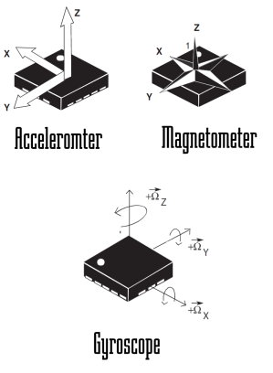
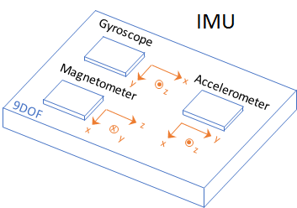
Sensors for motion

Slide 49
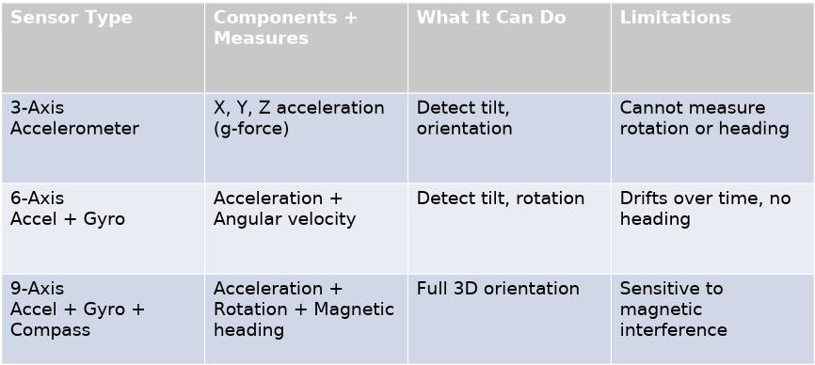
Notes:
0.5-3 USD
3-5 USD
5-20 USD

Slide 50
Activity Recognition usecases
Human Activity Recognition. Health, medical, sports https://github.com/jonnor/embeddedml/blob/master/applications/human-activity-recognition.md
Animal Activity Recognition. Pets, livestock, wild animals https://github.com/jonnor/embeddedml/blob/master/applications/animal-activity-recognition.md
Other TinyML tasks related to motion / IMUs
Gesture Recognition https://github.com/jonnor/embeddedml/blob/master/applications/gesture-recognition.md
Condition Monitoring of Machinery https://github.com/jonnor/condition-monitoring

Slide 51
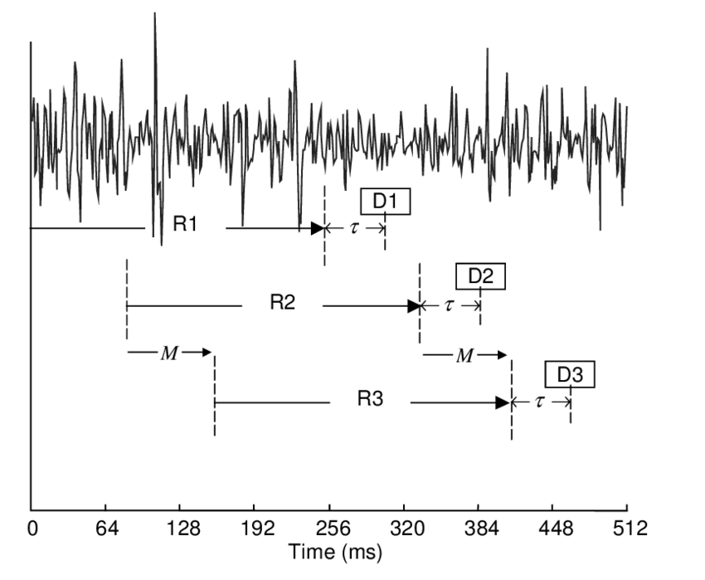
ML on streams: Continuous classification
The sensor data stream is sliced into overlapping windows.
Each window processed independently
Preprocess
Model
Raw sensor data
Features
Class
[ x1 y1 z1 x2 y2 z2
…. ]
[ 42, 4002, … , 329 ]
“Jumping Jacks”
Notes:
The sensor data steam is conceptually infinite
The Machine Learning models on the other hand must have finite and fixed-length inputs
This is done by splitting the stream at fixed intervals of time. Into windows
Usually with some overlap. So model gets multiple chances at predicting the same phenomena

Slide 52
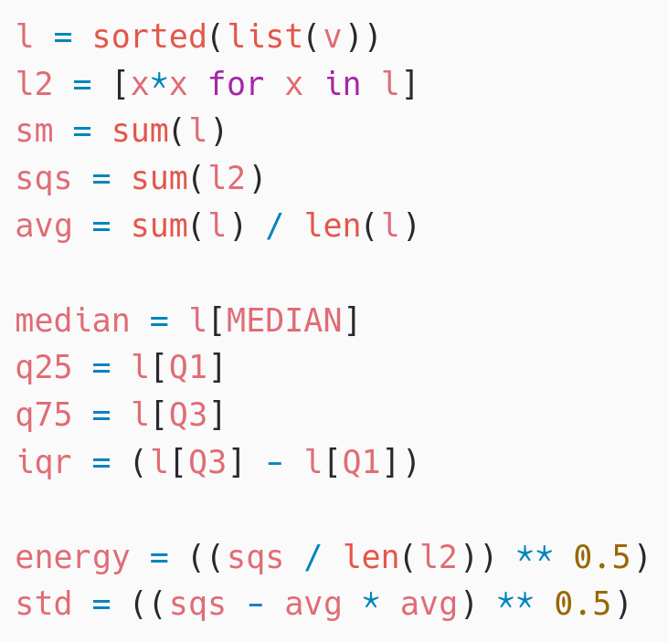
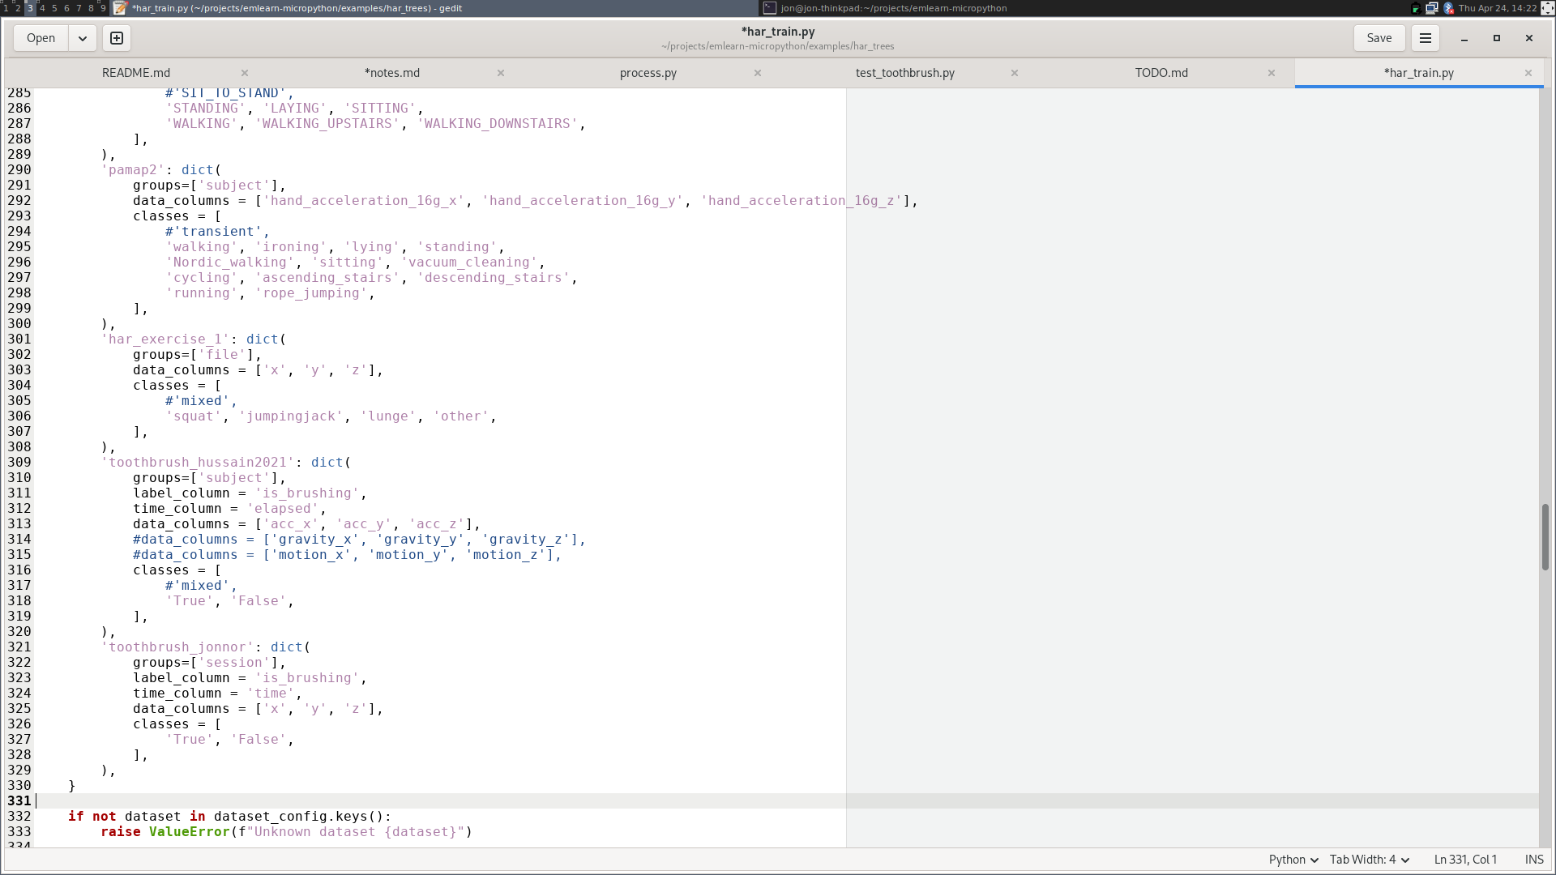
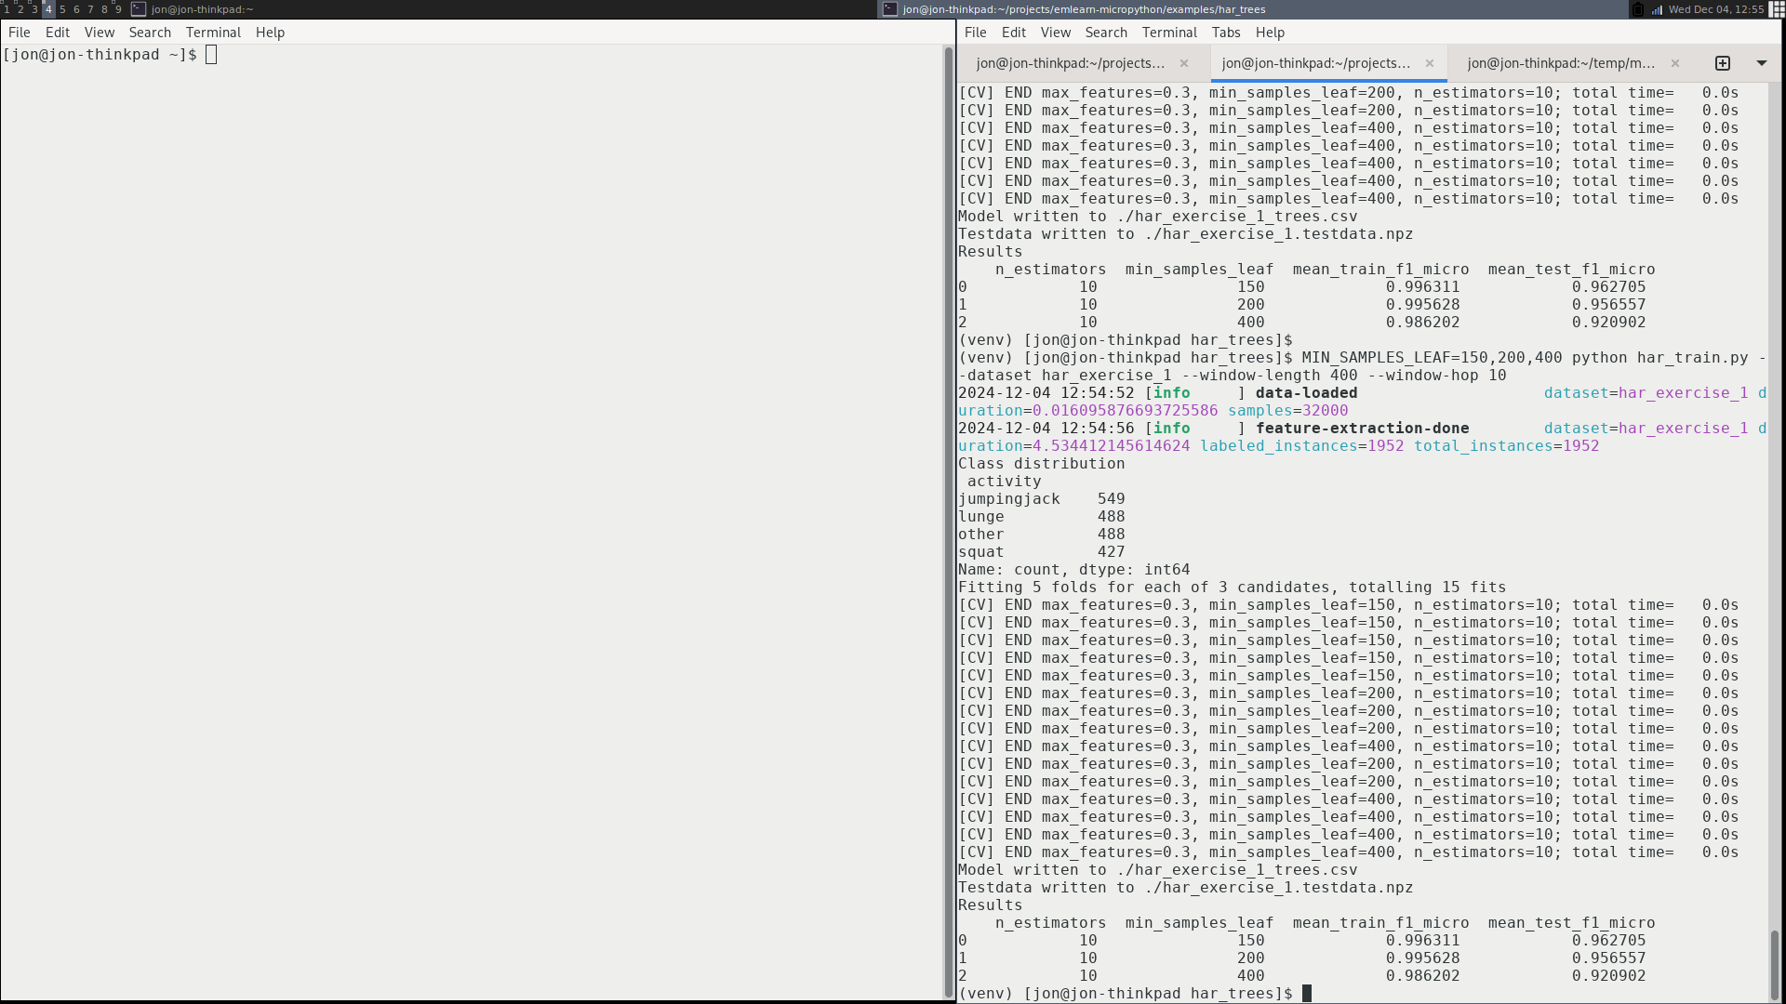
har_trees - Machine Learning pipeline
Using a scikit-learn based pipeline.
# Setup subject-based cross validation
splitter = GroupShuffleSplit(n_splits=n_splits, test_size=0.25,
random_state=random_state)
# Random Forest classifier
clf = RandomForestClassifier(random_state = random_state,
n_jobs=1, class_weight = "balanced")
# Hyper-parameter search
search = GridSearchCV(clf, param_grid=hyperparameters,
scoring=metric, refit=metric, cv=splitter)
search.fit(X, Y, groups=groups)
import emlearn
converted = emlearn.convert(clf)
converted.save(name='gesture', format=’csv’, file='model.csv')
https://github.com/emlearn/emlearn-micropython/tree/master/examples/har_trees

Slide 53
Native module (.mpy) VS External C module
 | Native module | External C module
Installable at runtime | Yes, as .mpy file | No. Must be included in firmware image
Requires SDK/toolchain | No (only to build) | Yes
Code executes from | RAM | FLASH
Limitations | Limited hardware access | None
Maturity | Medium * | Excellent
Documentation | https://docs.micropython.org/ en/latest/develop/natmod.html | https://docs.micropython.org/ en/latest/develop/cmodules.html
* Improved greatly in MicroPython (1.25+). Thanks to Volodymyr Shymanskyy, Alessandro Gatti, Damien George, and others

Slide 54
Compute constraints
RAM
64 kB
Reserved
FLASH
512 kB
Reserved
ML pipeline
Post-processing
Post-processing
Memory (RAM)
Program space (FLASH)
Inference time (CPU)
Energy (battery)
Model
Model
Pre-processing
Pre-processing
Sensor reading
Sensor reading
System/ Application
User interface
Drivers
Drivers
CPU
Cortex M4F
User interface
Connectivity
Connectivity
Active time
Send
Send
Sleep zzzzZZZ
Energy
Total time
Time
Notes:
Inline and loadable (data structure) Majority voting instead of class probabilities Leaf-node de-duplication

Slide 55
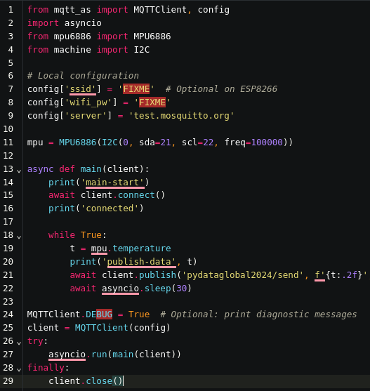
Temperature sensor - code
1. Read the sensor in a loop
2. Send data using MQTT
3. Wait until next measurement
The same approach usable for other slow-changing phenomena Using https://viper-ide.org/ with Chromium
Zero-install. Connect to device via USB
Notes:
Temperature is a slow changing phenomena. Want: 1 value for longish time interval (ex: 5 min)
! Sensor can be noisy. Filtering advised
Will show analog sensor example. Same approach can be used for a digital sensor. And for other slow-changing phenomena.

